Slide 1



Mountain Bike Suspension ​
Team 20FB14: Austin Coyne, Dylan Klemp, Erik Abraham, Jacob Cryder, Suliman Alsinan, Tyson Spencer​

Slide 2
Project Description
Mountain bike suspension lacks the capabilities to quickly and easily adjust for different terrain on the fly and needs to have a tuning option to allow for a more comprehensive system. Mountain bike suspension can be adjusted but can sometimes be difficult to understand for the average consumer. So, the team needs to create an easier way to help even beginner mountain bikers be able to alter their suspension settings. ​
Jacob

Slide 3
UGRADS Video
(6) NAU Mountain Bike Suspension Capstone - YouTube

Slide 4

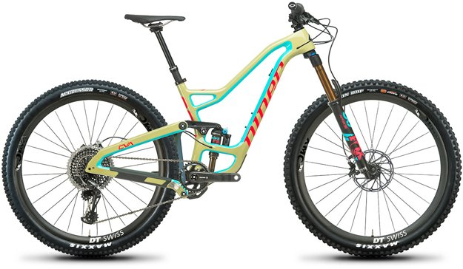
Client and Sponsors
Client
  Brandon Lurie​: Engineer at W.L. Gore
Sponsors
  W.L. Gore​
  Niner Bikes​: Provided the team with a bike to use for testing ​and industry knowledge/direction
Sully

Slide 5
Customer/Engineering Requirements
Customer Requirements
Engineering Requirements
Base research off current mathematical models
Extensive research on the suspension system and bike frame
Ensure that an average customer can use the design
Incorporate both a solid works model and math model
Validation testing (field work modeling)
Spring rate and damping rate are critically damped or slightly under damped for all given terrains (Ns/m)
Validate mathematical model with other models (% diff.)
Compatible with test bike (mm)
Minimize Weight Addition to Bike (g)
Compact design to fit on handlebar of bike (cm^3)
Ensure durability to withstand impacts and weather on trails (MPa)
Sully

Slide 6
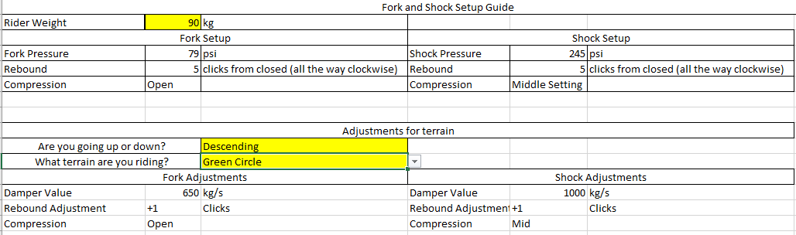
Design Solution (Mathematical Model)
[1]
Erik

Slide 7
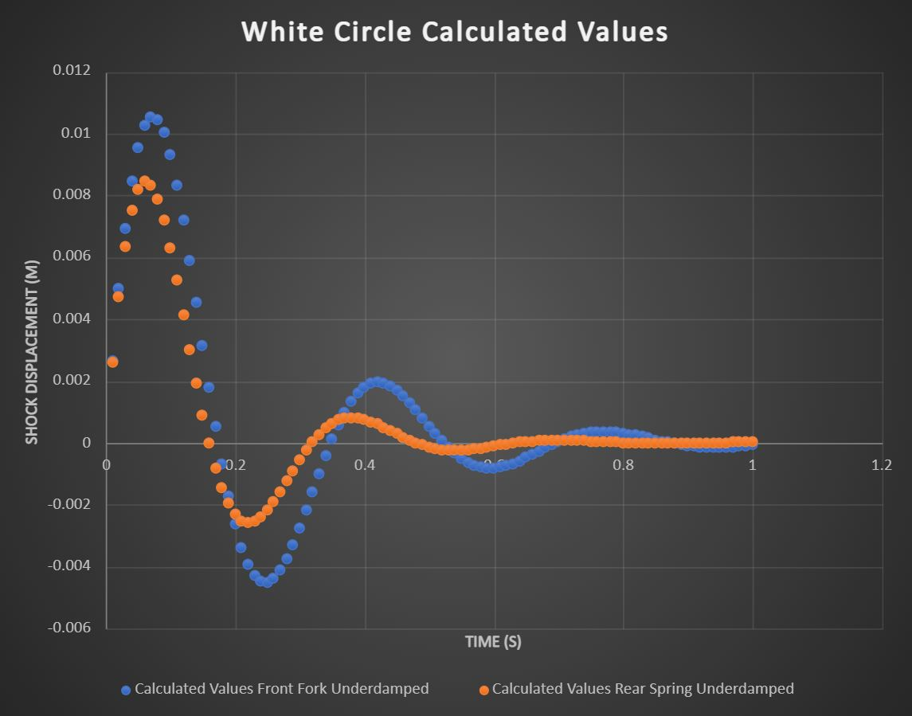
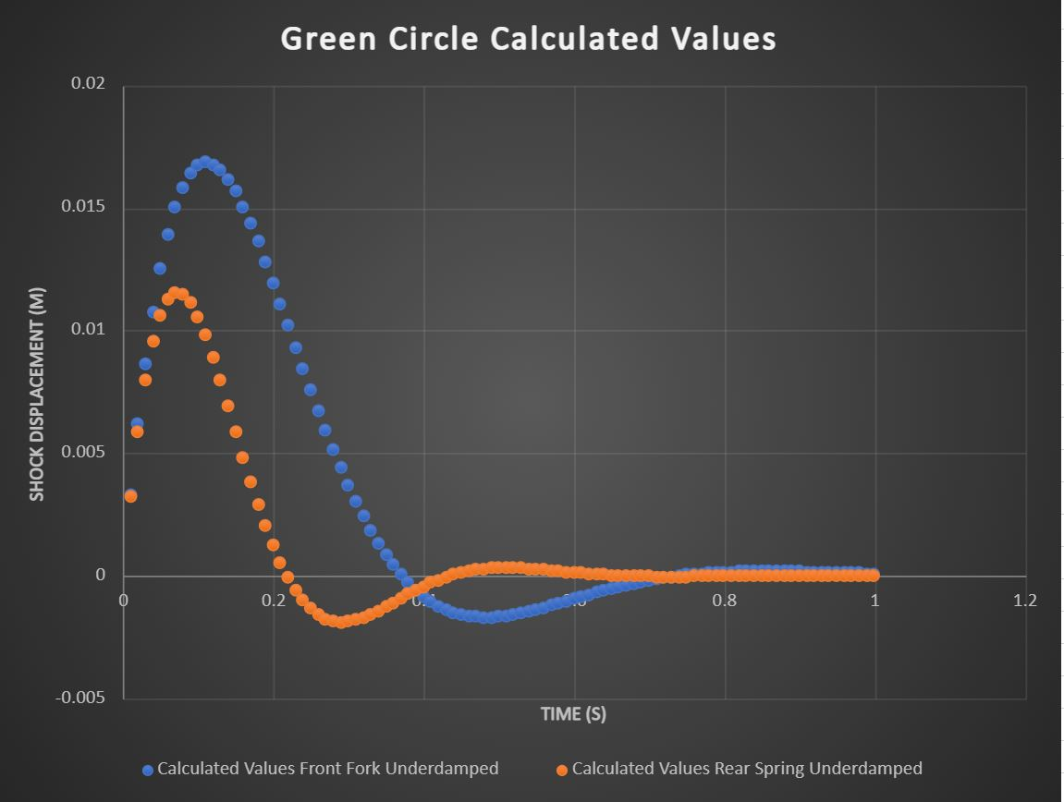
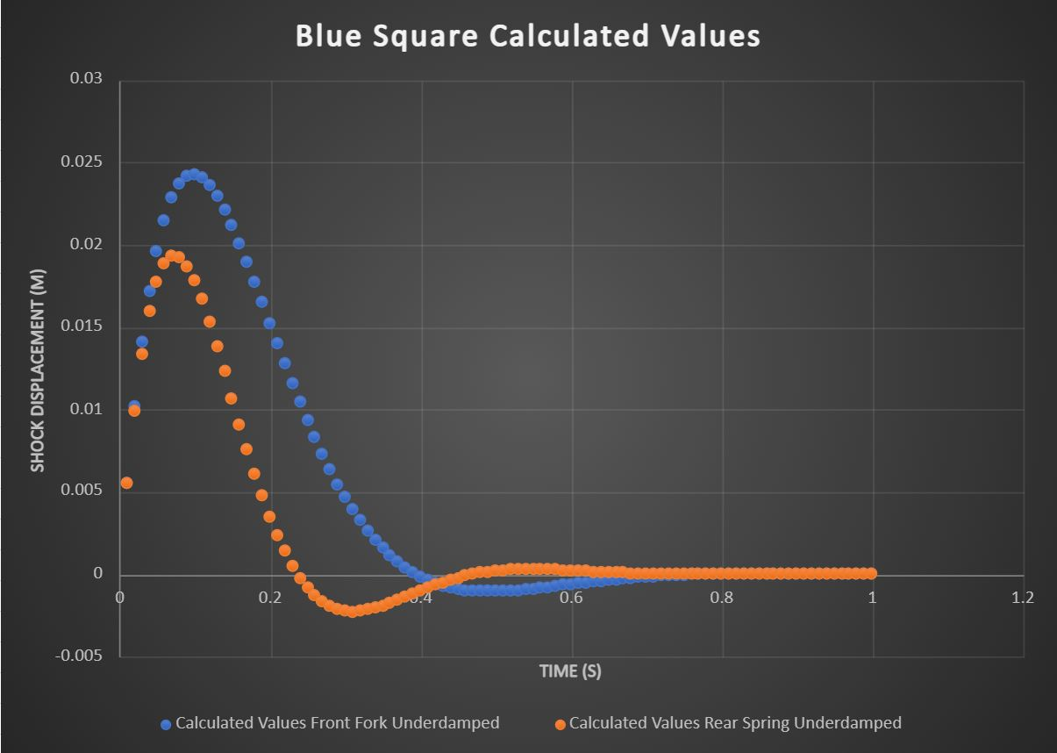
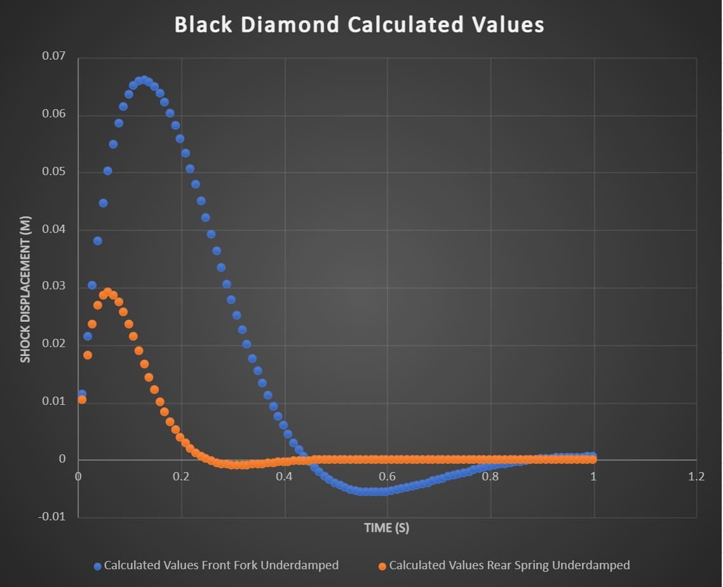
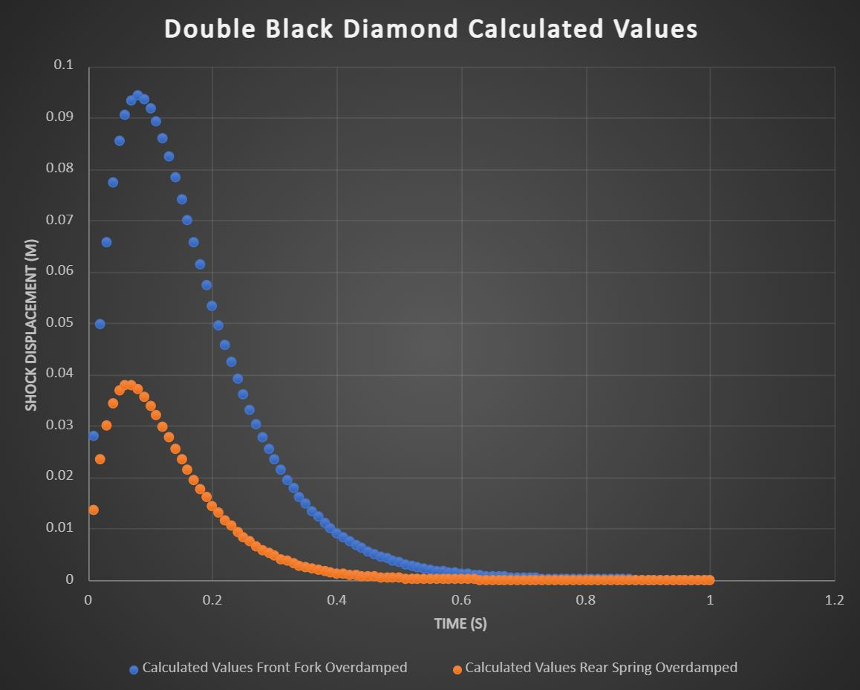
Design Solution (Mathematical Model)
[1]
Tyson

Slide 8
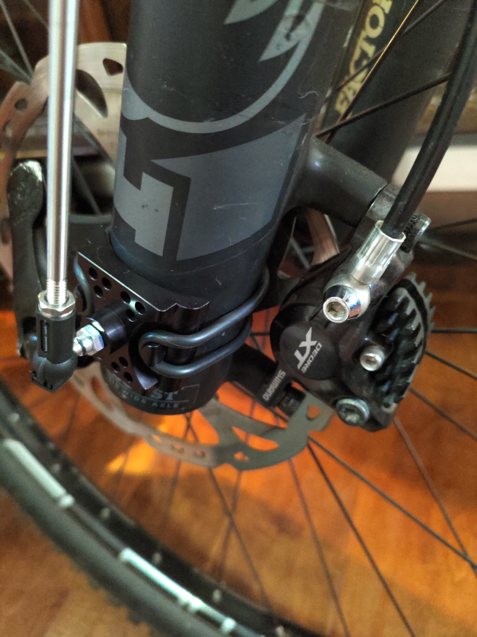
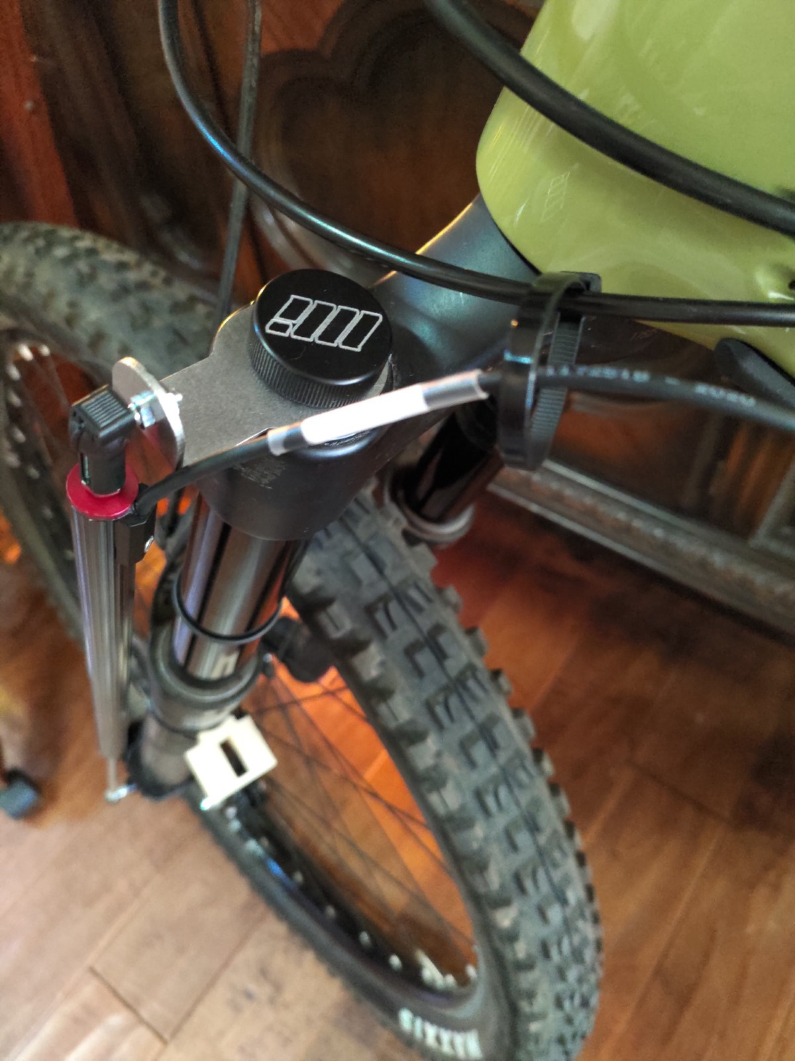
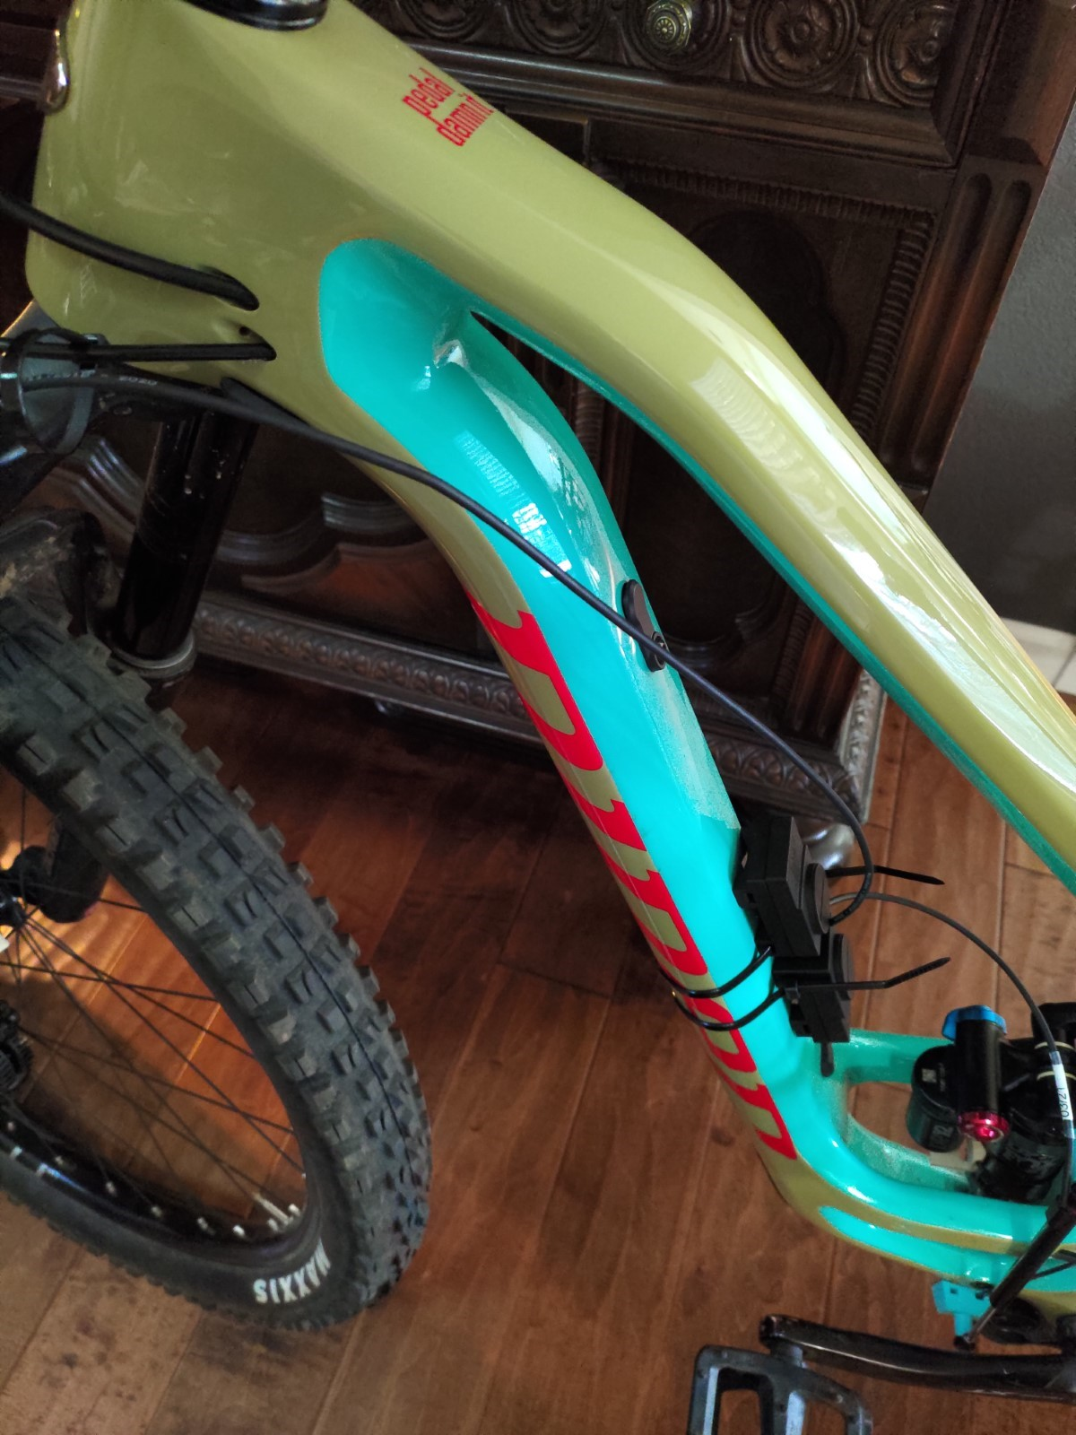
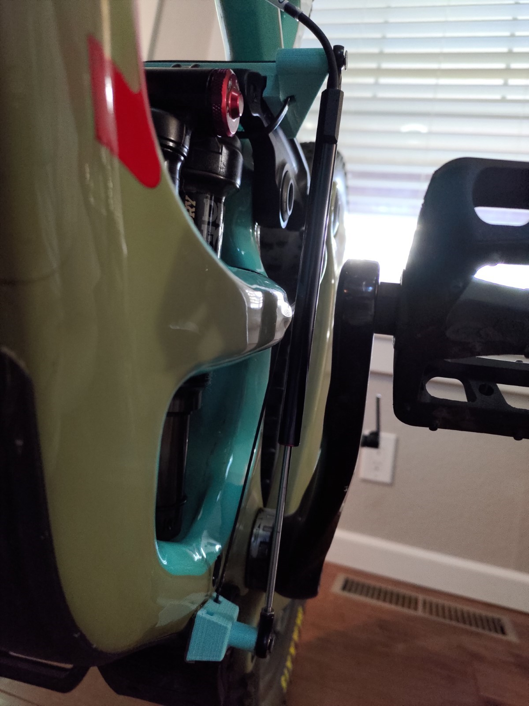
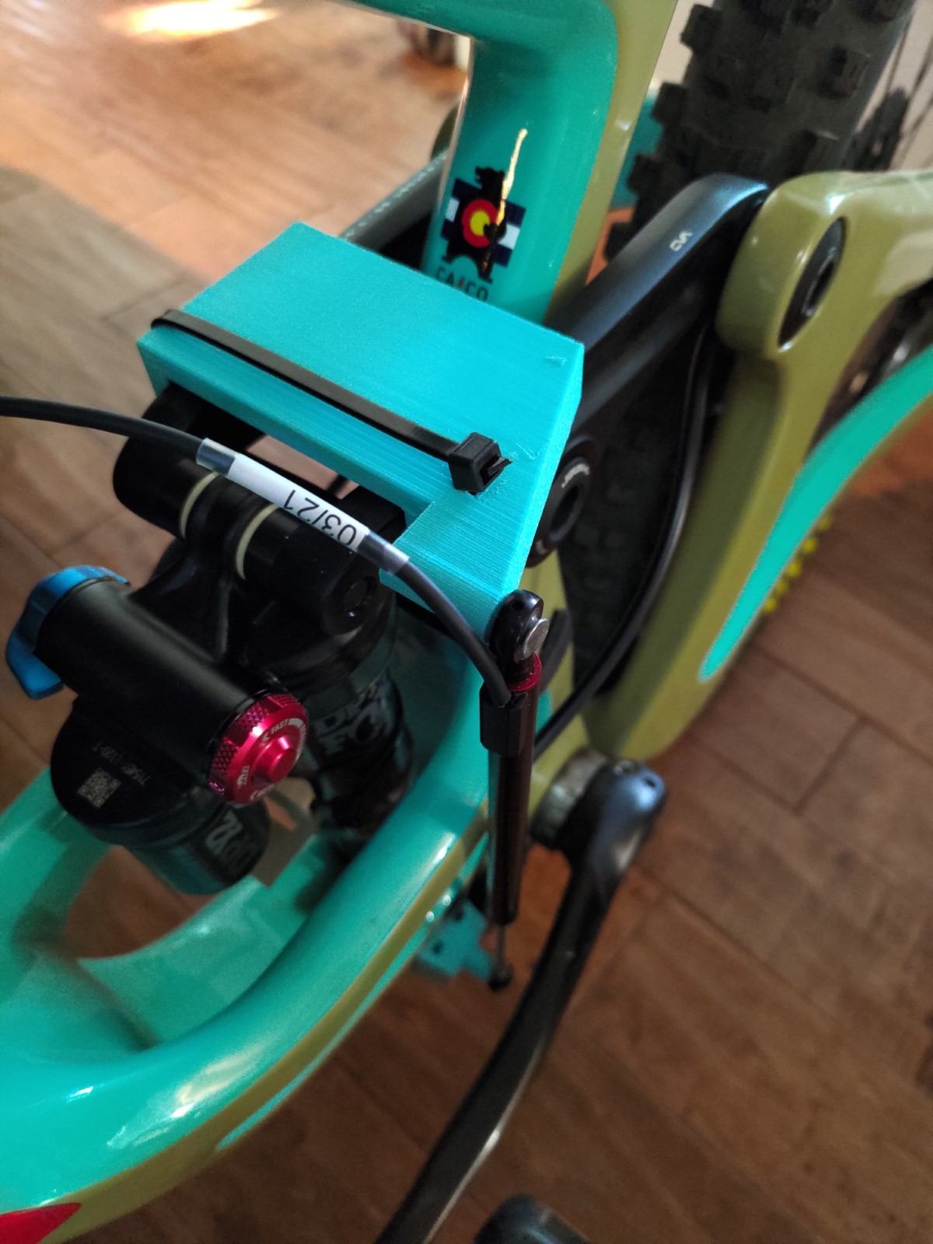
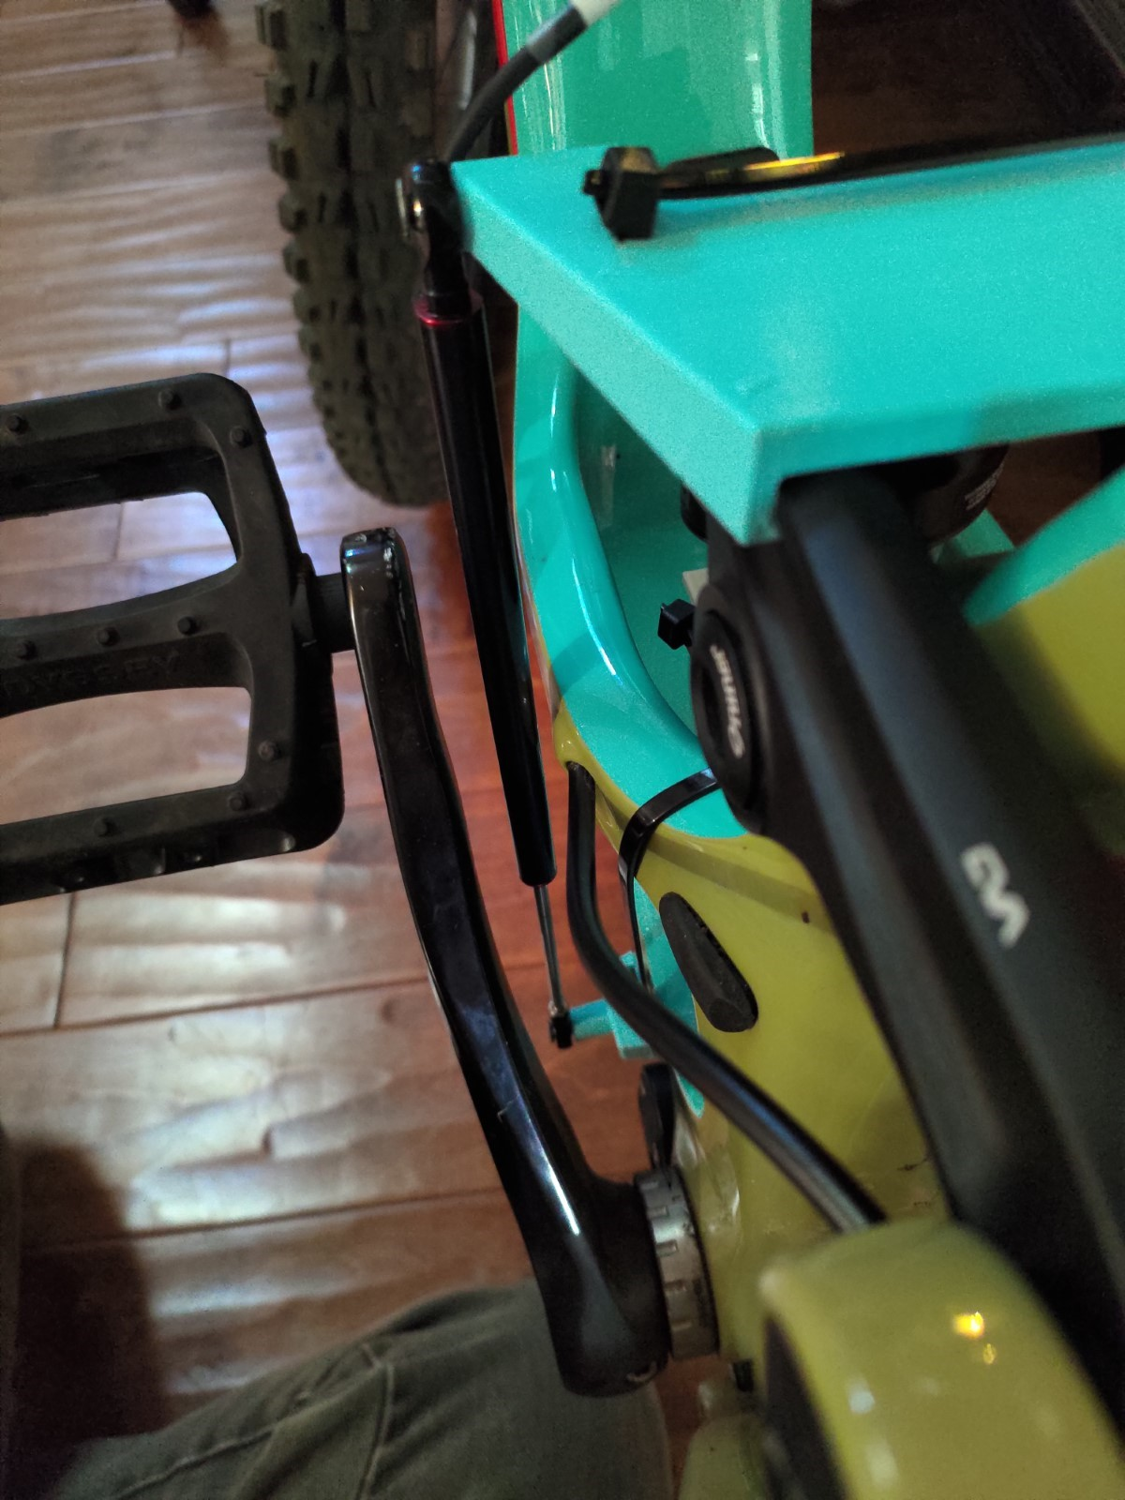
Final Testing Apparatus
[2]
Tyson

Slide 9
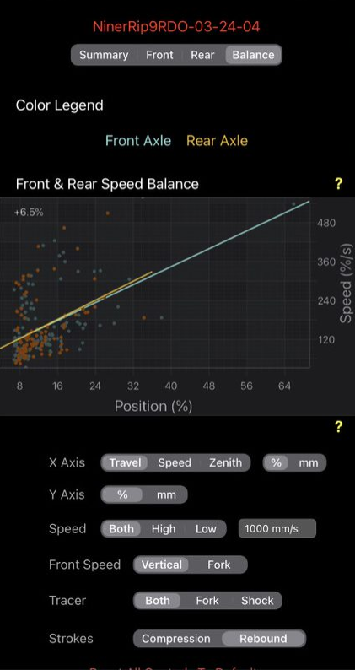
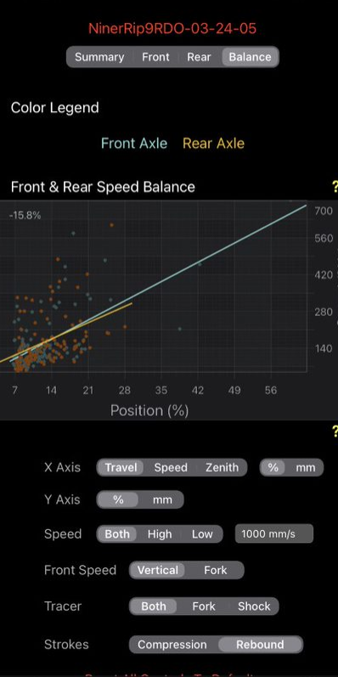
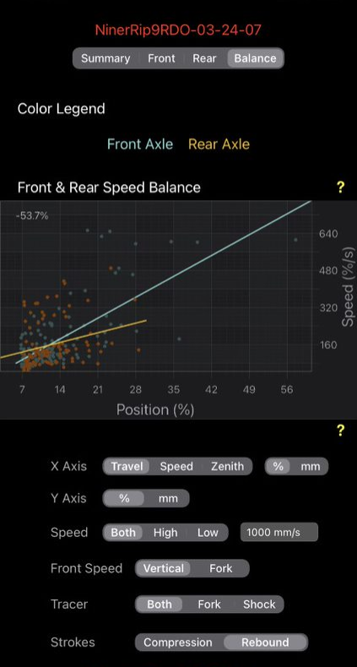
Testing (Linear Potentiometer)
Erik

Slide 10
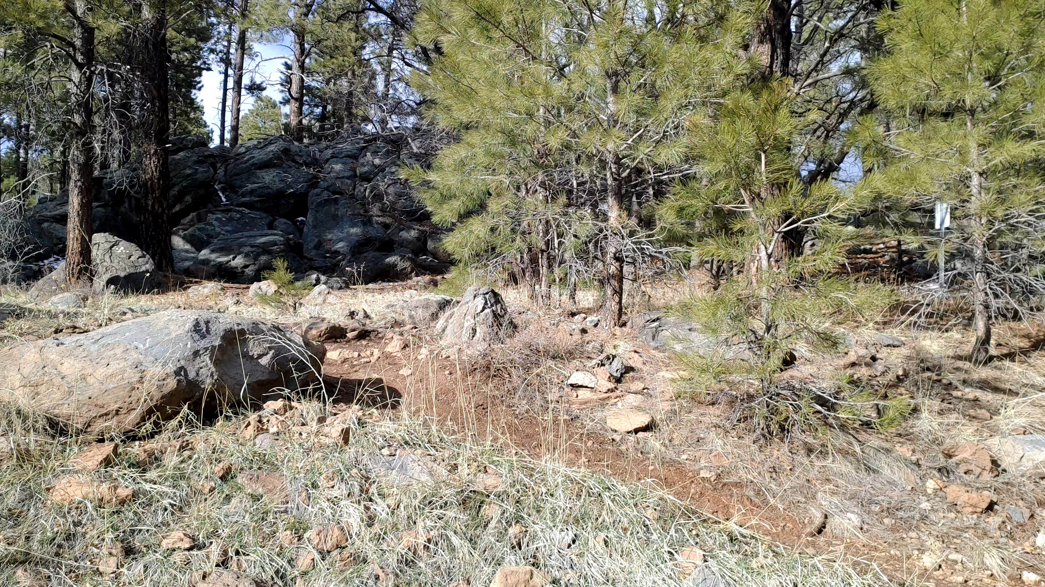
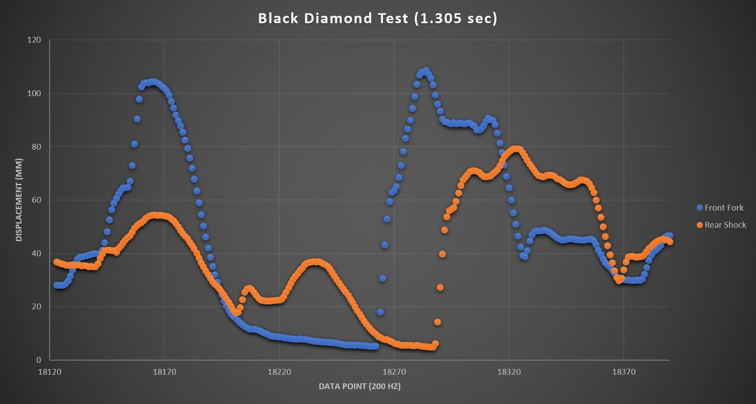
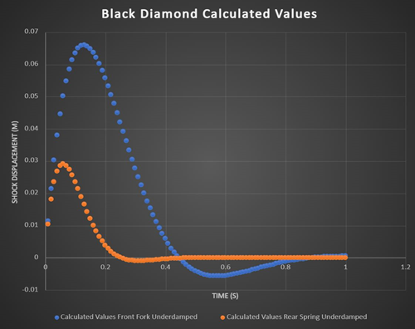
Calibration/Validation of Math Model
[1]
Tyson

Slide 11


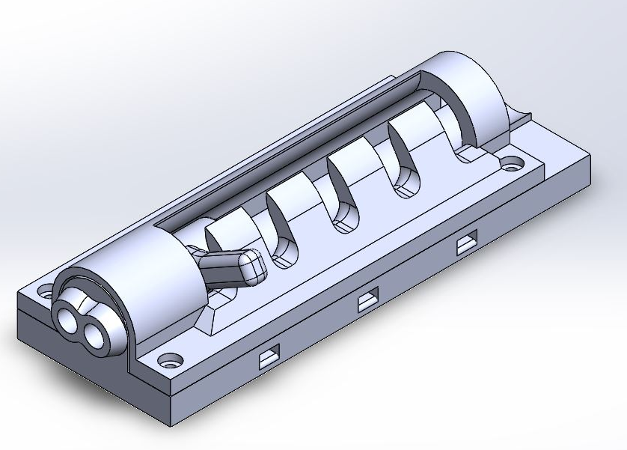


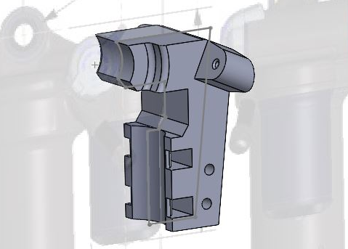


Design Solution (SolidWorks)
Needed a simple device to switch suspension settings
Went through the design process
Decided on mechanical device and designed the device in SolidWorks
Design relies on a switcher mechanism, a cable, and springs
Austin

Slide 12
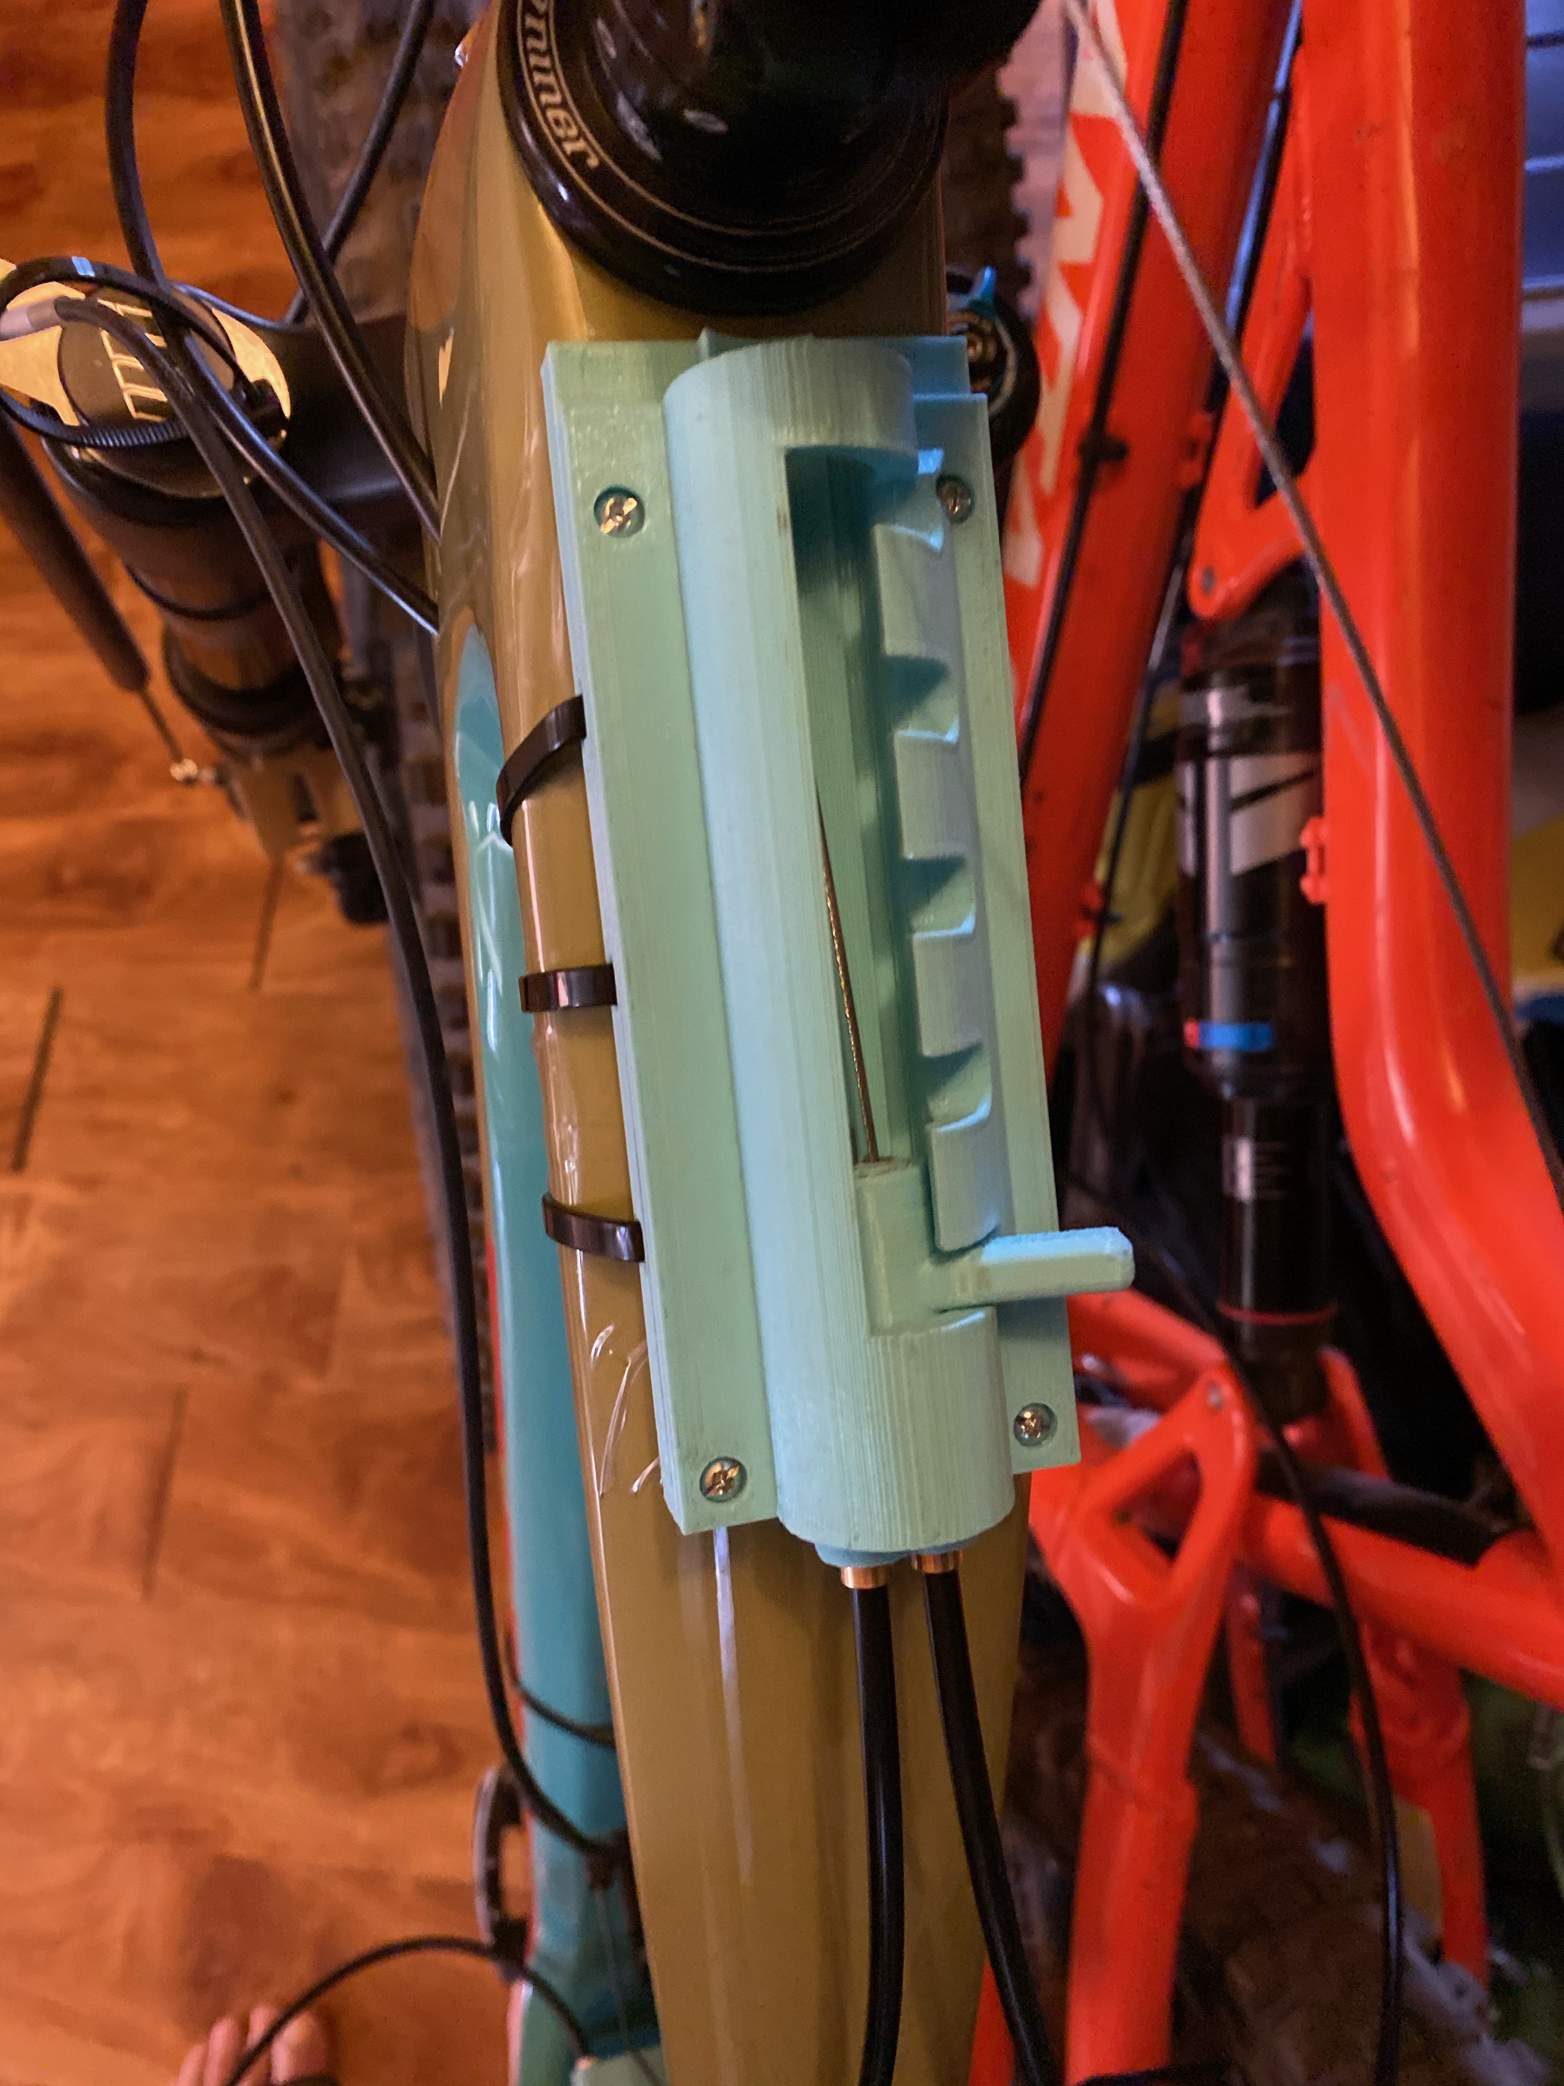
Manufacturing
3D Print Basis
  Relied on 3D printed components courtesy of the MakerLab at Cline Library
  Made it easy to test and adjust parts quickly
Other Sourced Parts
  Used shifter cable and housing from bike shifters
  Purchased screws, zip ties, and all other hardware
Austin

Slide 13
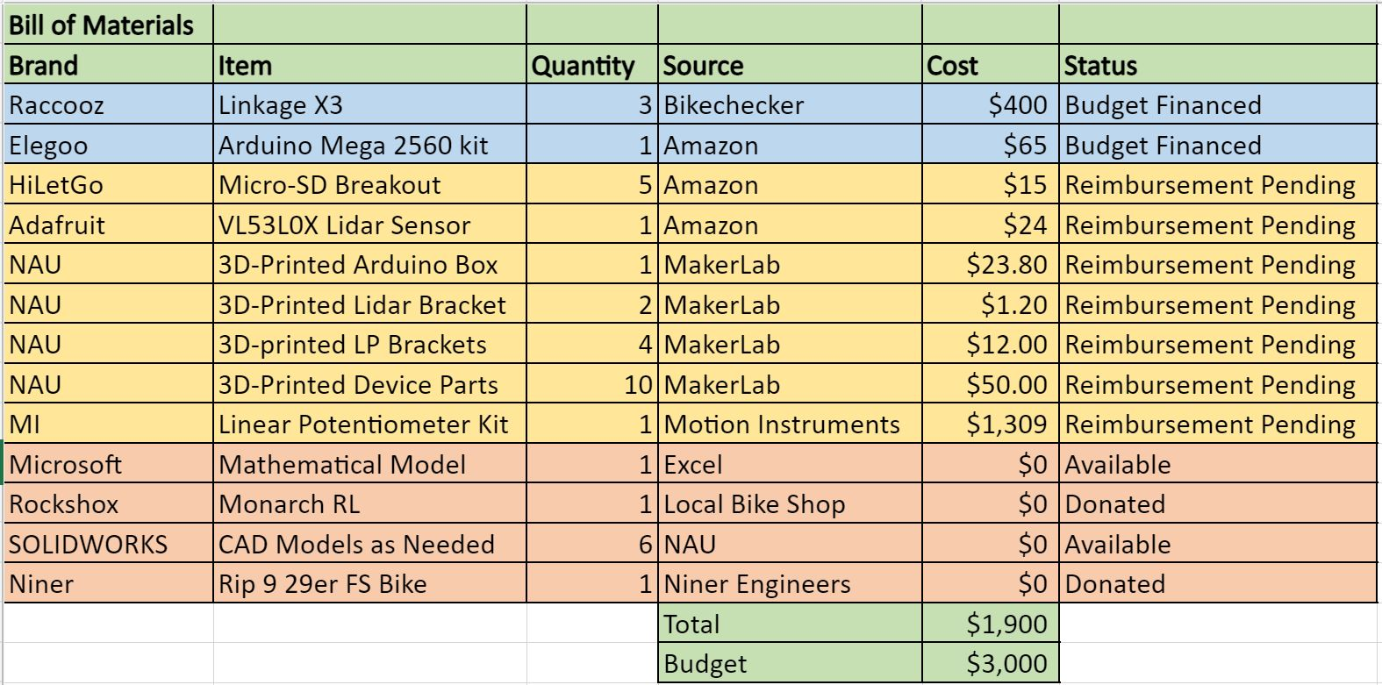
Budget
[1]
Dylan

Slide 14
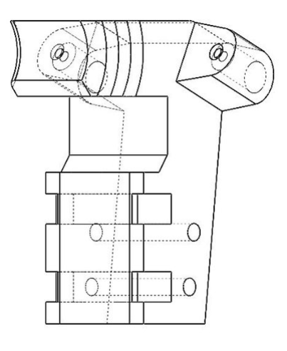
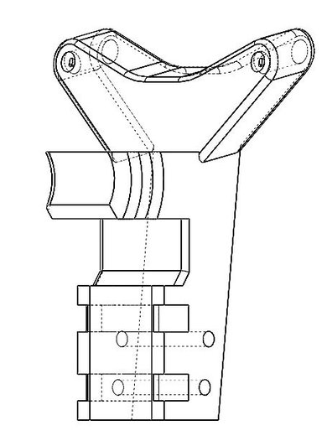
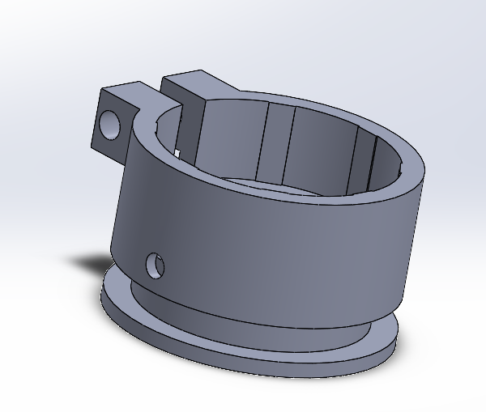
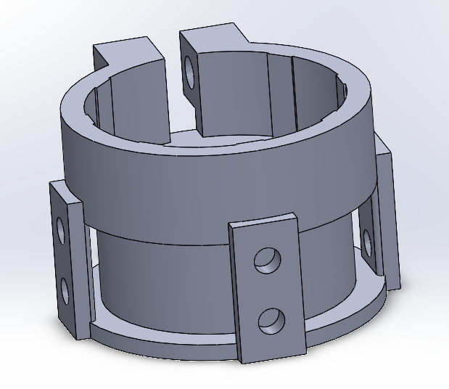
Future Work
Minor Part Redesign
  Shock Bracket Changes for Clearance Issues
  Suspension Knob Changes for Better Wire Routing
Mathematical Model Format
  Web or IOS based User Interface for Suspension Setting Guide
Original Knob
Redesigned Knob
Original Bracket
Redesigned Bracket
Dylan

Slide 15

Questions?

Slide 16
References
[1] E. Abraham, T. Spencer, “Updated Math Model,” Microsoft Excel, Flagstaff, 2021.
[2] Motion Instruments, “XC-Enduro Pro,” 2020

